Slide 1



MINI PROJECT
Foundations of Statistics and Probability
By Quantum Quads

Slide 2
Meet Our TEAM MEMBERS
MEMBERS:-
SAMIKSHA KAUSHIK
SURESH JANGID
KRISHNA PRATAP SINGH
ISHITA CHAUDHARY
ROLL NUMBERS:
B24BS2312
B24BS2371
B24BS2167
B24BS2137

Slide 3
INTRODUCTION
The project is a data analysis and strategy-building exercise for a quick-commerce startup facing operational issues. The team's task is to use statistical tools and data visualization to analyze company data, identify the root causes of problems like declining revenue and customer churn, and present a data-backed plan to improve delivery efficiency and customer retention.

Slide 4
DATA ANALYSIS
What the Numbers Tell Us?
Customer Feedback Analysis: A summary of customer feedback reveals the top complaints are late deliveries and item unavailability. This directly correlates with a sharp increase in customer churn and app uninstalls.
AOV Decline: Our analysis confirms a significant decline in AOV over the last two quarters, indicating customers are spending less per order.
Benchmarking: When compared to industry benchmarks like Zepto and Blinkit, our average delivery times are 2x higher in specific high-traffic zones.

Slide 5
PROBLEMS
Inefficient Delivery Logistics: There is a strong correlation between long delivery times in specific areas and negative customer ratings, leading to dissatisfaction.
Poor Inventory Management: The company frequently runs out of stock for high-demand products, resulting in a poor customer experience and abandoned orders.

Slide 6
GOALS
The primary goals of this project are to diagnose the core operational problems at QuickBazaar using a data-driven approach, apply statistical concepts to analyze delivery and customer data, and then present a recovery strategy to management based on the findings. The ultimate objective is to improve customer satisfaction and increase growth by solving the underlying issues.

Slide 7
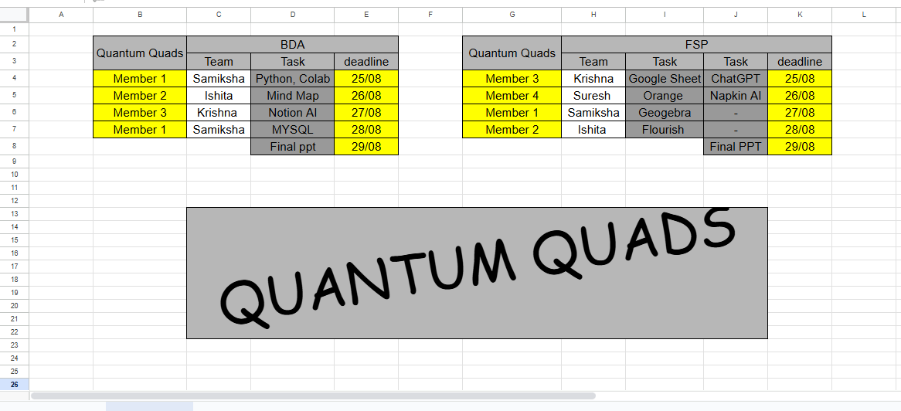
THE STRATEGY
Using the Google Sheets assigned the to each other set the deadlines And planned accordingly

Slide 8
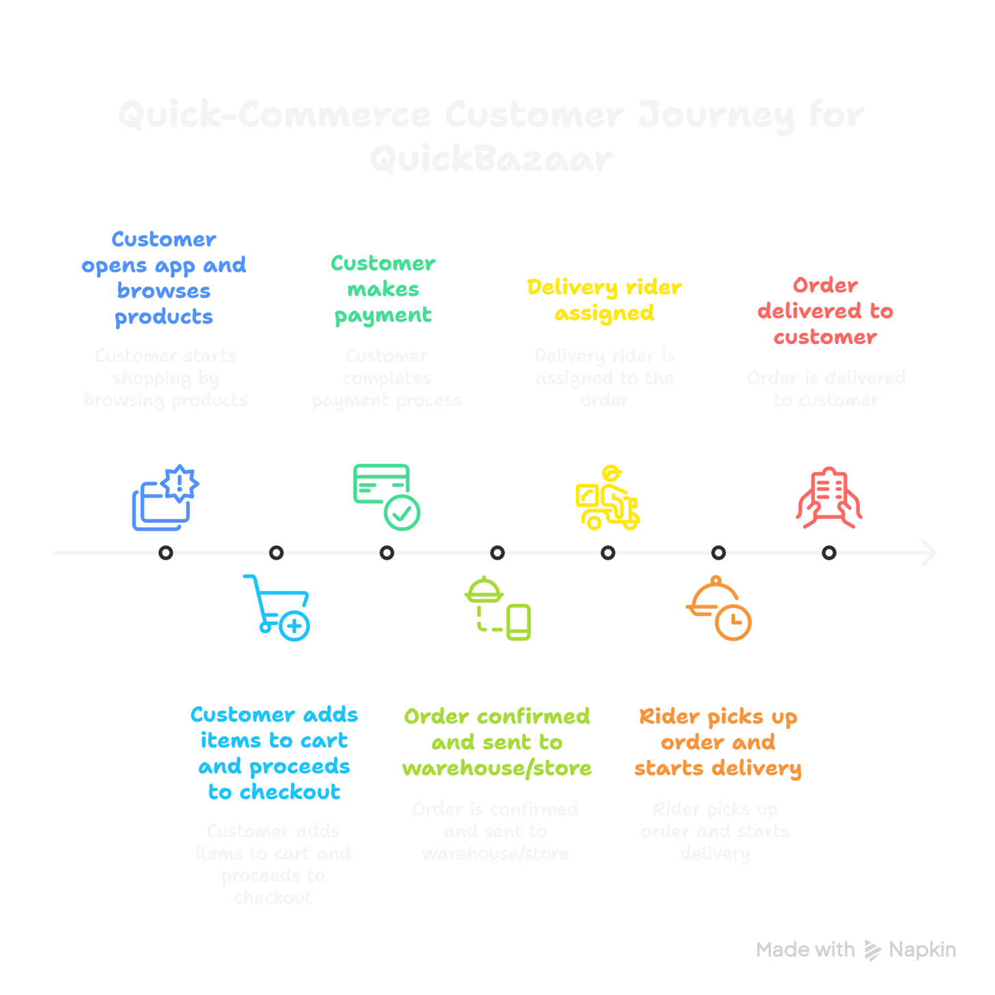

Order Journey Map
Made using Napkin AI

Slide 9
ORANGE
Importing the Datasets: The first step is to import the provided datasets—Order & Customer Data, Delivery & Operations Data, and Inventory Data—into the Orange visual programming environment.
Using Distribution Widgets: The handout instructs the use of Orange's "Distributions" widget to visualize the spread and patterns of key variables, such as delivery times and customer ratings. This helps in understanding the data's overall behavior.
Creating a Heatmap: A heatmap is used to identify initial correlations between different variables. A specific use case mentioned is to see the relationship between "Pincode" and the frequency of "Late Deliveries." This visual analysis helps in quickly spotting problem areas, which can then be further investigated with more precise statistical methods.

Slide 10
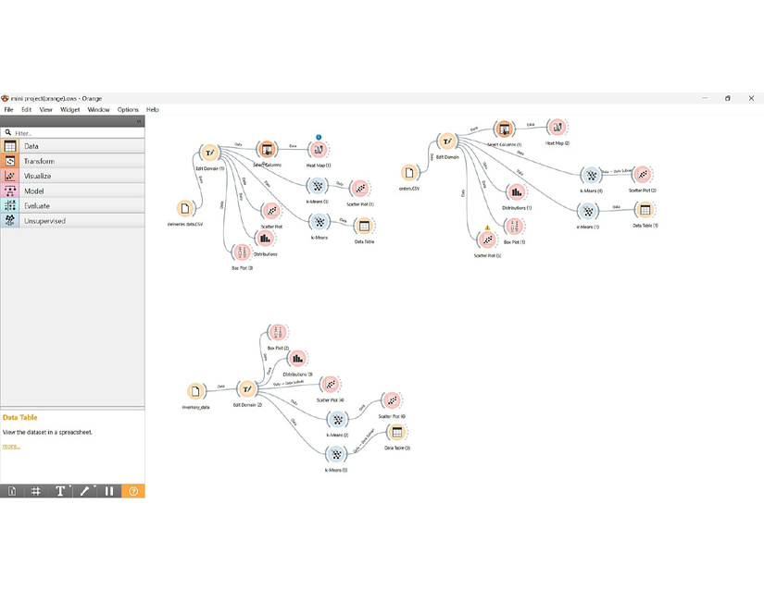
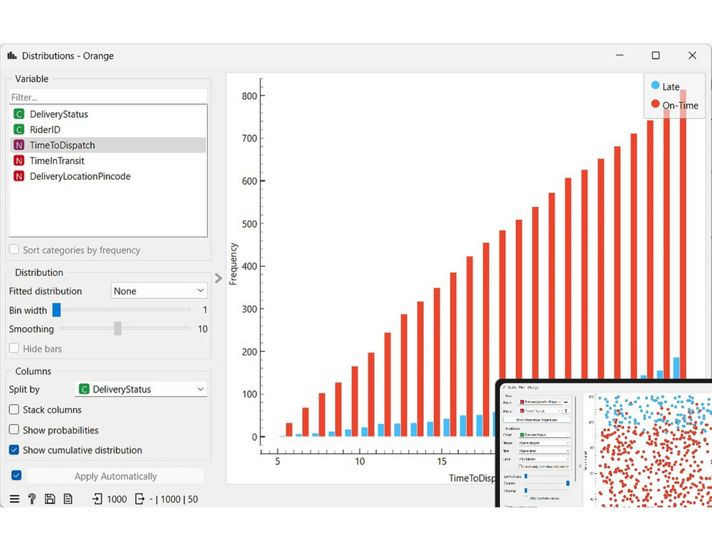
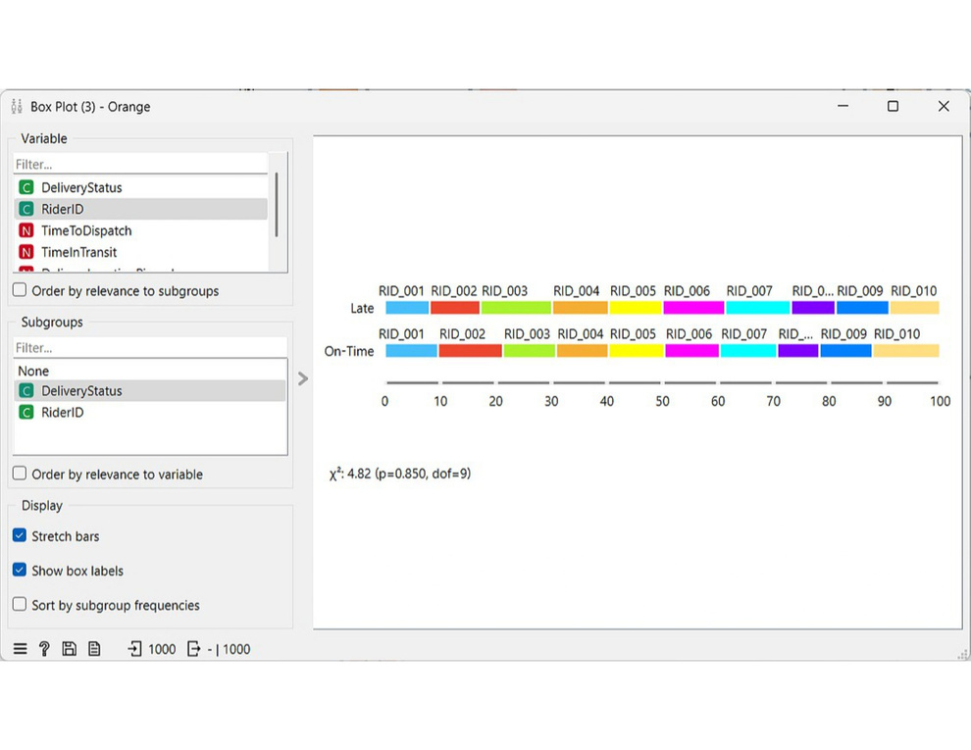
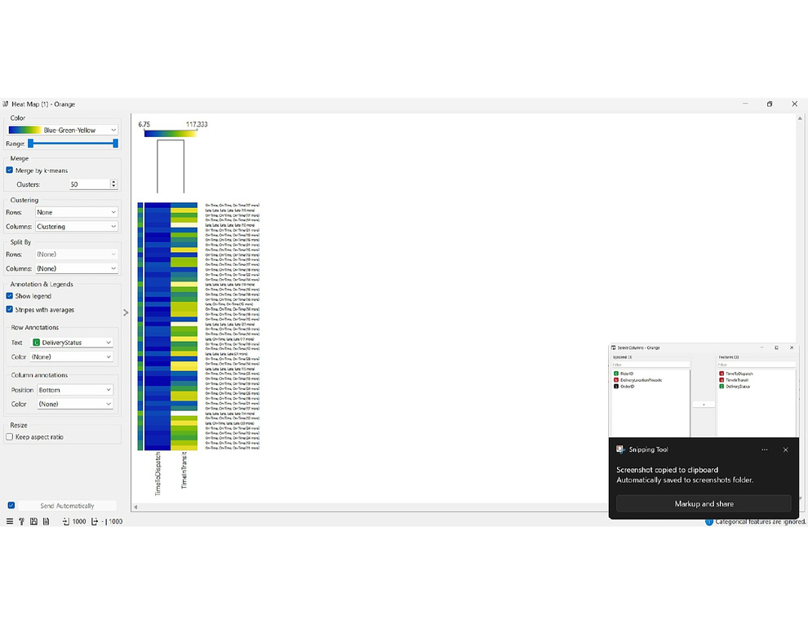
ORANGE EVIDENCES
LINK

Slide 11
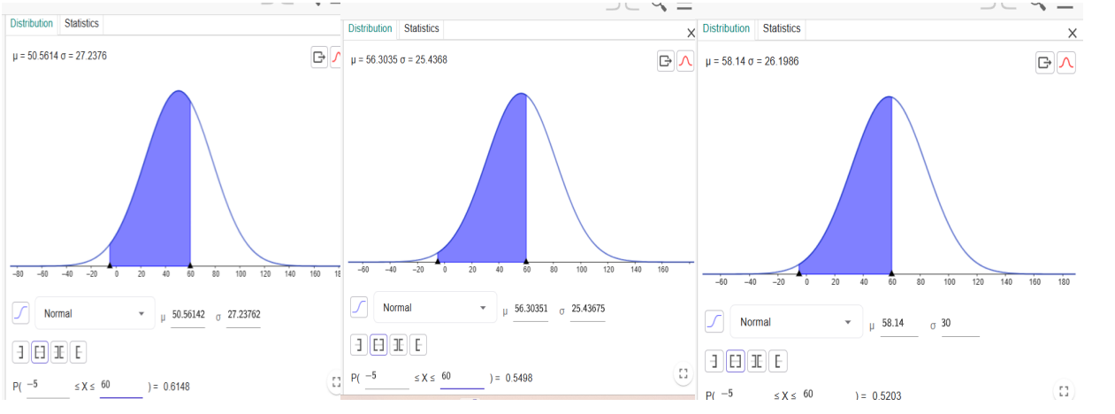
GEOGEBRA EVIDENCES
LINK

Slide 12
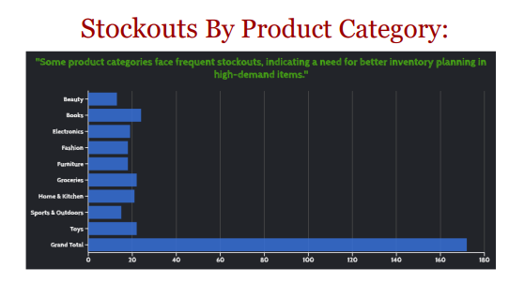
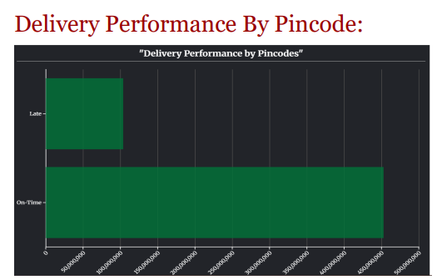
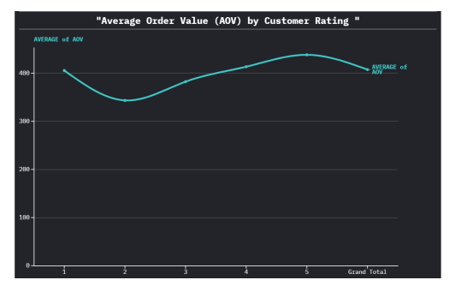
FLOURISH EVIDENCES
LINK

Slide 13
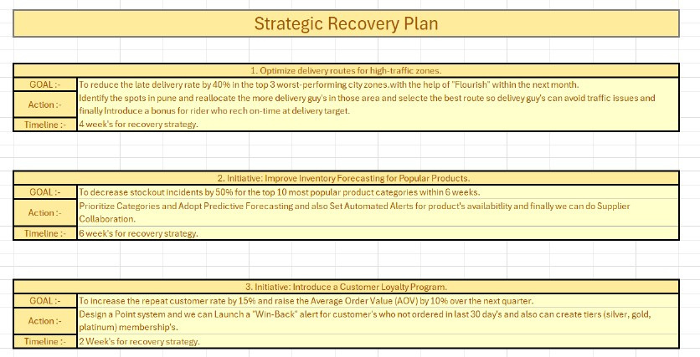

Slide 14
STORY
As the new Data Analyst at the struggling startup QuickBazaar, I was tasked with fixing our delivery crisis. With customer complaints soaring and growth stalled, I used data to find the root cause.
In Google Sheets, I discovered our average (mean) delivery time was a high 48 minutes, but the median was only 28. This high variance showed that a few disastrously late orders were skewing the numbers. Using a tool called Orange, I found a strong correlation between delays and orders placed after 6 PM.
To see where this was happening, I mapped the late orders on GeoGebra, revealing three specific "hotspot" neighborhoods. The probability of a late delivery in these zones during peak hours was over 70%.
The problem wasn't random; it was a predictable bottleneck.
I used Flourish to visualize a targeted recovery plan: pre-position riders near hotspots before the evening rush, batch orders in dense areas, and offer off-peak discounts. The data-driven strategy was approved, and within weeks, our delivery times stabilized, customer satisfaction rose, and QuickBazaar was back on the path to success.

Slide 15
HANK
T
oU
Y

